Slide 1
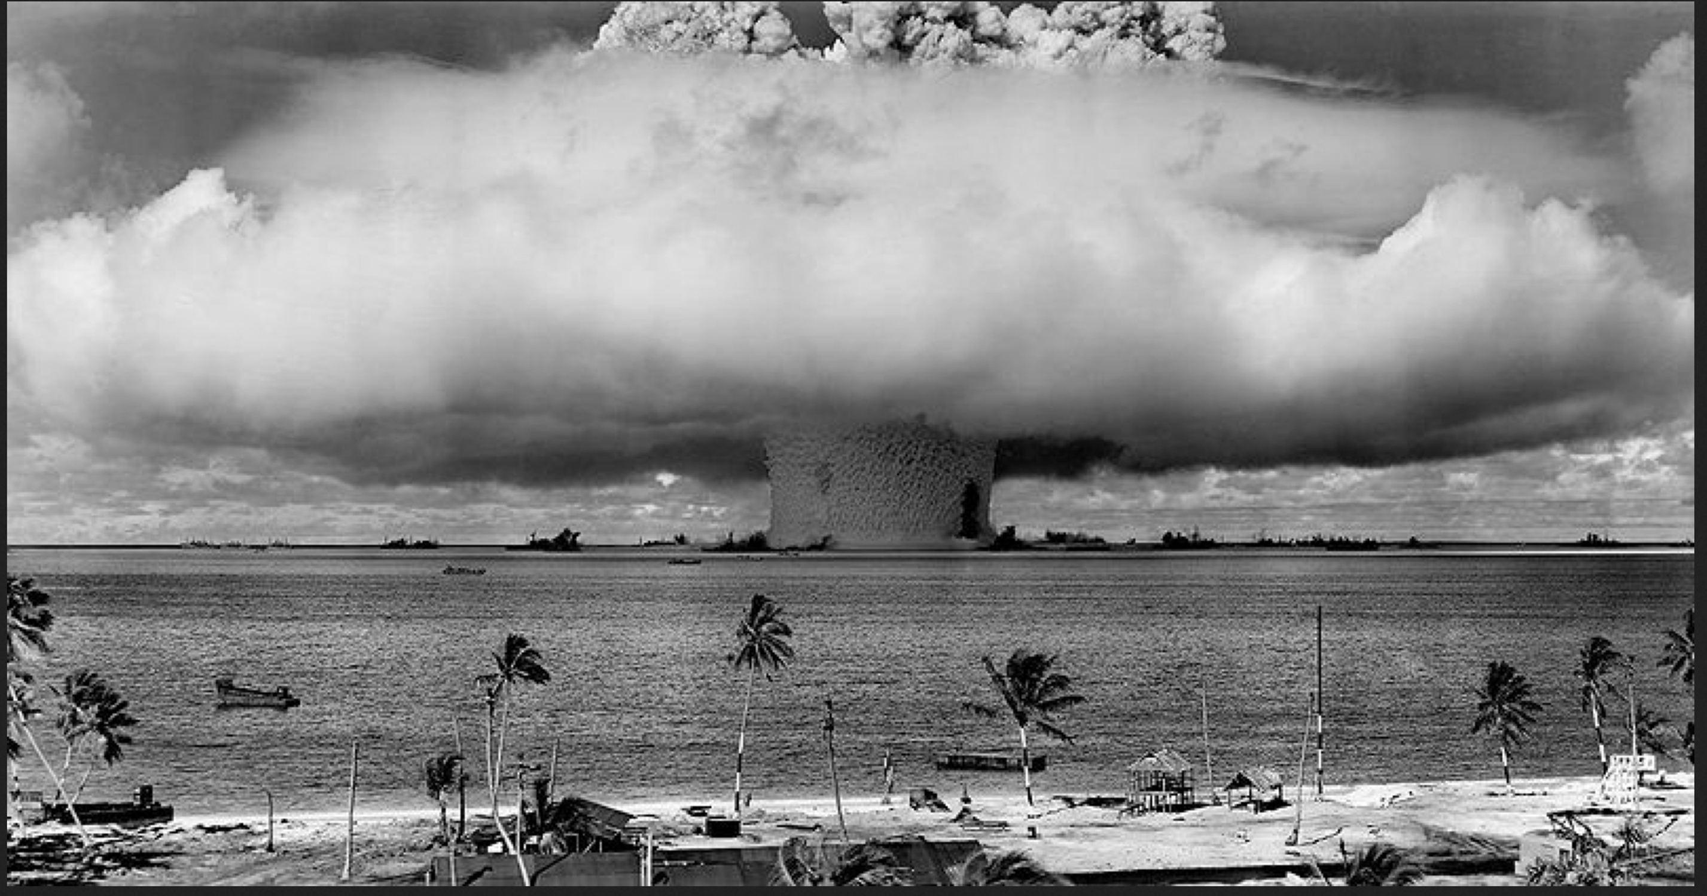
A STORY OF RADIOACTIVITY, THE RISKS OF NUCLEAR POWER with a few CULTURAL REFERENCES
Notes:
march 1 1954 the US tested its biggest nuclear bomb ever in the Marshall Islands. It was a disasater, spraying radioactive fallout on Rongelap Atoll p 100 miles and on a Japanese fishing trawler, 86 miles away the LUcky Dragon..Many in Rongelap became sick. One man on the trawler died. Flying over the Marshall Islands, soon after, TOMOYuKI TANAKU was inspired to create the Godzilla movie. .
FALLOUT BECAME A COMMON TERM; THIS MONSTER ACTIVATED BY RADIOACTIVE FALLOUT EXPRESSED THE STRUGGLE BETWEEN NATURE AND THE BOMB

Slide 2
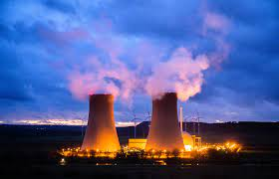
5 REASONS WHY NUCLEAR ENERGY IS NOT THE SOLUTION TO THE CLIMATE CRISIS
Notes:
. in 1954,the US rushed to get a nuclear power plant up and running to show that atoms could be used for peaceful purposes. The head of the atomic energ commission pronounced taht nuclear energy would be too cheap to meter though Some scientists and industrialists disagreed.

Slide 3
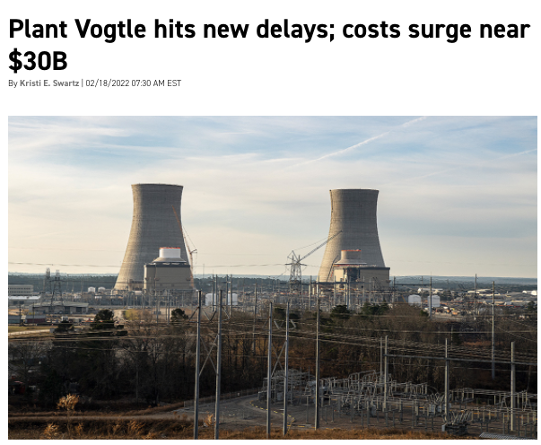
1) LONG DELAYS AND
2) RISING COSTS. REGULATIONS UNIQUE TO RADIOACTIVE RISKS
Notes:
PLNAT VOGTLE IN GEORGIA IS THE FIRST NEW NUCLEAR POWER PLANT IN US IN 30 YEARS. Consgtruction started in 2012,Supposed to open 2016,2017( now 2023 for first and 2024 for second reactor) , Westinghouse reactor designer bankrupt and costs more than double to $30 billion from original estimate of $14 million. COSTSand DELAYS. STARTED IN 2012 .Georgia Power ratepayers on the hook for most of the costs. https://www.eenews.net/articles/plant-vogtle-hits-new-delays-costs-surge-near-30b/

Slide 4
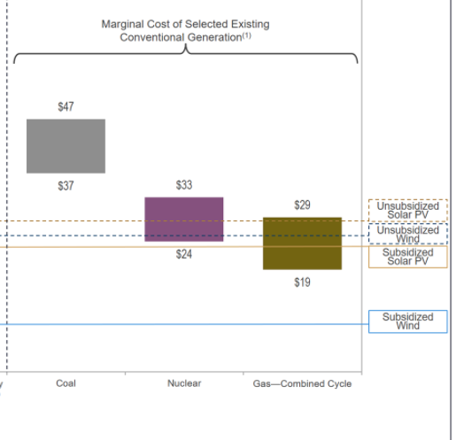
COSTS
COMPARING COSTS OF NEW RENEWABLES WITH EXISTING COAL AND NUCLEAR
Notes:
Ocotber 2021. https://www.lazard.com/perspective/levelized-cost-of-energy-levelized-cost-of-storage-and-levelized-cost-of-hydrogen/
comparing existing power plants (coal, nuclear and gccp) with new renewable . Even this is cost competitive. Lines for renewable represent lower limits of cost for the renewable.. LCOE cost competitive for renewables with existing conventional
Per Mark Jacobs: does not take into account: cost of delays, meltdowns, and costs of storing wastes( someone has to pay for it) currently $500 million/year for 100

Slide 5
3) CARBON FOOTPRINT AND POLLUTION ARE NOT ZERO
Related to delays, Fossil fuel derived air pollution during 10-19 year delay in becoming operational, excess annual deaths pm2.5 related and ozone
Carbon footprint from mining, refining, water vapor and heat
Legacy pollution from mining, and wastes
Notes:
https://pubs.acs.org/doi/10.1021/acs.estlett.0c00424. Annually in the US deaths from pm2.5 pollution are estimated at 100,000-200,000

Slide 6
4) PROLIFERATIVE RISKS: Nuclear power provides the infrastructure, expertise and technology.
ENRICHING URANIUM 235 FROM 3-5% (LEU) TO >90%
PLUTONIUM 239 FROM REPROCESSED SPENT FUEL : <20 lb to make a bomb...
ENRICHING URANIUM FROM 3-5% (LEU) FOR NPP TO >90% U235 FOR NUCLEAR WEAPENRICHING URANIUM FROM 3-5% (LEU) FOR NPP TO >90% U235 FOR NUCLEAR WEAPON: Khan, Pakistan, learned enrichment in Europe, stole plans, list of suppliers and helped Pakistan, N Korea and Iran develop centrifuges for U235 enrichment
PLUTONIUM FROM REPROCESSED reactor spent fuel: Britain, France, Soviet Union. India learned from Atomic Energy Commission how to separate spent fuel which it did to get enough plutonium to make their first bomb
ON: Khan, Pakistan, learned enrichment in Europe, stole plans, list of suppliers and helped Pakistan, N Korea and Iran develop centrifuges for U235 enrichment
PLUTONIUM FROM REPROCESSED reactor spent fuel: Britain, France, Soviet Union. India
Notes:
AbdulKhan, from Pakistan Pakistan, learned enrichment in Europe, stole plans, list of suppliers and helped Pakistan, N Korea and Iran.
India and Israel acquired research reactor and reprocessing technology under atoms for peace from US, Canada, and Europe. N Korea developed a small reactor and through reprocessing its plutonium was able to make its nuclear weapons
Nuclear power provides the technology, expertise and infrastructure for nuclear weapons production. (Insurmoutable Risks , Brice Smith, IEER Press. https://www.amazon.com/Insurmountable-Risks-Dangers-Nuclear-Climate/dp/1571431624. STOP
To make an atomic bomb you need a radioisotope that can sustain a chain reaction and with nuclear power you can get both u235 , the Hiroshima bomb fuel and plutonium, the Nagasaki bomb fuel.

Slide 7
5) HEALTH AND ENVIRONMENTAL RISKS RELATED TO RADIOACTIVITY
MINING URANIUM: CHRONIC LUNG DISEASE AND CANCER /NAVAJO NATION.
CONTAMINATION AND EXPOSURE: FROM REACTOR MELTDOWN (CHERNOBYL AND FUKISHIMA)
DANGER FROM THE WASTE: SPENT FUEL POOL FIRE OR EXPLOSION EVEN LARGER POTENTIAL FOR ENVIRONMENTAL CONTAMINATION AND HUMAN EXPOSURE. when moved to dry casks, MUST BE STORED FOR ETERNITY. Risk of radioactive release.

Slide 8
URANIUM MINING and ENVIRONMENTAL LEGACY: Environmental Injustice
Notes:
. For miners, there is An increased risk of lung cancer from uranium decay product radon and radon daughters daughter and slilicosis from the dust in uranium miners,
https://www.epa.gov/navajo-nation-uranium-cleanup/abandoned-mines-cleanup
From 1944 to 1986, nearly 30 million tons of uranium ore were extracted from Navajo land. More than 500 of the abandonmed uranium mines, half of the total, are on Navajo land. Homes were built with uranium tailings which caused exposjre to radon gas. Homes and water contaminated with elevated radiation levels (EPA 2021) Risk of lung, bone cancer, kidney damage, and other disease.
Studies of proximity to uranium mines have found increased hypertension, autoimmune disease ,Rev Environ Health 2011;26(4):231–249

Slide 9
Reactor accidents: CHERNOBYL April 26, 1986
EXPLOSION, FIRE, MELTDOWN AND COVER-UP
LAND CONTAMINATION: evacuation zone 1622 sq miles.
Evacuation over 300,00
COSTS: $235 billion
DEATHS: 10,000-50,000 long term
Radiation :>400x Hiroshima
Environment: Russia, Ukraine, ¼ of Belarus; pine forests, animals died. (animal numbers are rebounding in absence of humans).
2019 STILL 1550 SQ MILE EXCLUSION ZONE. study still Sr90 and Cs 137 contaminate grains and firewood
Notes:
Alert came from NPP worker in Sweeden , 1100 km away who saw a rise in radiation levels.Thryoid cancers in children: Ukraine, Russia, Belarus; childhood leukemias in Ukraine; : total cacners small increase in a small study in Sweden that related the Cs137 contamination map with deaths, Finally study of Chernobyl liquidators found increase in solid cancers,, digestivecancers. \
Land around the reactor will be uninhabitable for 20,000 years Land around reactor uninhabitable 20,000 years. https://www.nationalgeographic.com/culture/article/chernobyl-disaster
CULTURAL Chernobyl as a media for global art. Diggit Mag. Murals in the exclusion zone , Nobel prize-winning author Svetlana Alexievich for her book, Chernobyl Prayer basis of , miniseries HBO Chernobyl, Pink Floyd music video Marooned.
https://ideas.ted.com/after-a-nuclear-disaster-then-what-a-surprising-look-at-the-animals-of-chernobyl-and-fukushima/
https://www.sciencedirect.com/science/article/pii/S2212420918304163 study of Stronium 90 () and Cs 137 still contamination in soil and trees.
https://www.ncbi.nlm.nih.gov/pmc/articles/PMC5223674/pdf/bmjopen-2016-011924.pdf
https://reader.elsevier.com/reader/sd/pii/S1470204502007271?
https://www.livescience.com/chernobyl-exclusion-zone
https://www.forbes.com/sites/jamesrodgerseurope/2021/05/01/ how-the-chernobyl-nuclear-disaster-shaped-russia-and-ukraine

Slide 10
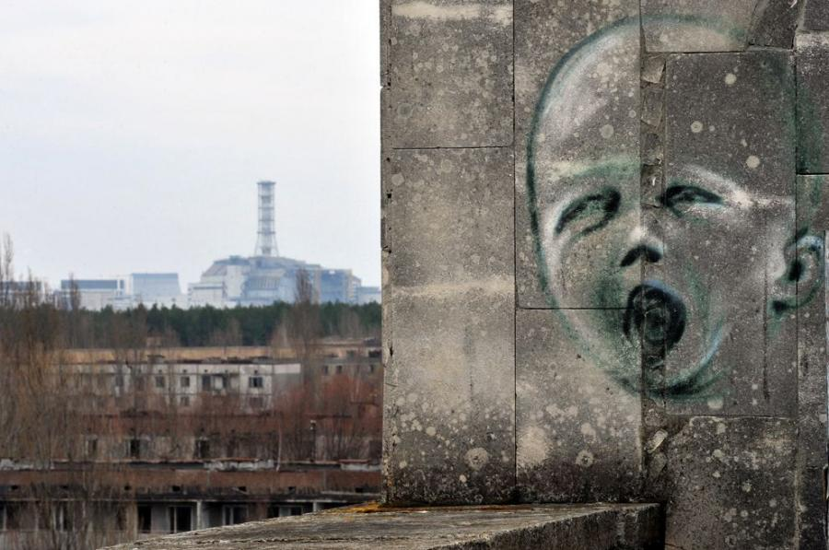
Notes:
CULTURAL Chernobyl as a media for global art. Diggit Mag. Murals in the exclusion zone , Nobel prize-winning author Svetlana Alexievich for her book, Chernobyl Prayer basis of , miniseries HBO Chernobyl, Pink Floyd music video Marooned
Mural in Prypiat by Polish artistsChernobyl could also be regarded as a museum given that it provides an illustration of humanity's progress in the development of energy. The place offers many certified tours (Figure 2) to the territory near the reactor, as well as the abandoned city of Prypiat

Slide 11
FUKUSHIMA MARCH 11, 2011: 3 REACTORS MELTDOWN AND MELT-THROUGH
LAND CONTAMINATION 444sq REFUGESS- 160, 000 initially ;
COSTS: $200 billion
Radioactivity 10% of Chernobyl release.
Now animals reappearing where humans are not
2021 Release of over 1 million tons radioactive water into the Pacific over 30 years contaminating fish and seafood
Notes:
https://link.springer.com/chapter/10.1007/978-981-13-8218-5_20 STORY OF 3 MELTDOWN AND MELT-THROUGHS
AFTER FUKUSHIMA DISASTER 2011, GODZILLA REAPPEARS ON THE INTERNET, IN CARTOONS, THE BRIDGE BETWEEN NUCLEAR WEAPONS AND NUCLEAR POWER AND MAN’S TECHNOLOGY UPSETING THE NATURAL ORDER.
Art exhibits exploring the relation between environment and nuclear technology, Japanese Art After Fukushima: Return of Godzilla is part of the Art + Climate = Change 2015 festival A bestseller and new movie Fukkushima 50
Costs disaster https://www.ncbi.nlm.nih.gov/books/NBK253929/

Slide 12
6) Spent nuclear fuel one of the most hazardous substances on Earth.”: Now at NPP sites
80,000 metric TONS + 2000 PRODUCED YEARLY IN THE U.S..
70% CURRENTLY IN SPENT FUEL POOLS: REQUIRE CONSTANT ELECTRICITY AND WATER... If a fire SFP at the Limerick NPP near Philadelphia,, radioactive release might contaminate an area twice the size of New Jersey.
DRY CASKS 30% OF SF; FUEL FROM SPF CAN BE MOVED IN CASK AFTER 5 yrs.; PASSIVE COOLING. NO ELECTRICITY. AT FUKUSHIMA, DRY CASKS REMAINED INTACT.
Release radioactive CS137, STRONIUM 90, PLUTONIUM 239 AND MUCH MUCH MORE
Notes:
SFP LINED STEEL AND CONCRETE https://thebulletin.org/2017/08/pushing-the-storage-horse-with-a-nuclear-waste-cart-the-spent-fuel-pool-problem/ Fire at Limerick, 8 million to evacuate, $2 trillion damages
https://www.energy.gov/ne/articles/5-fast-facts-about-spent-nuclear-fuel
80,000 metric tons uranium in spent fuel increasing at 2000 metric tons a year. https://www.eia.gov/todayinenergy/detail.php?id=47796
In 10,000 years waste will be 90% plutonium
For example, a 1100 MWe pressurized water reactor may contain 193 fuel assemblies composed of over 50,000 fuel rods and some 18 million fuel pellets

Slide 13
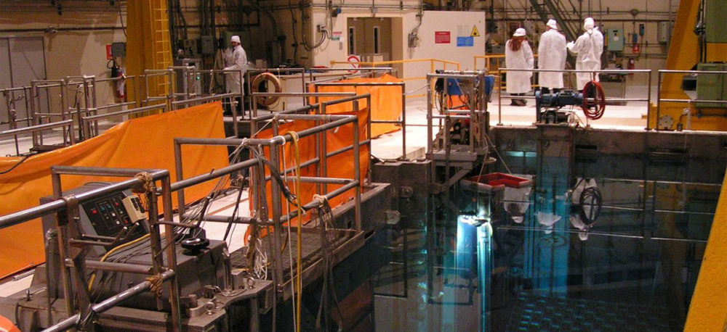
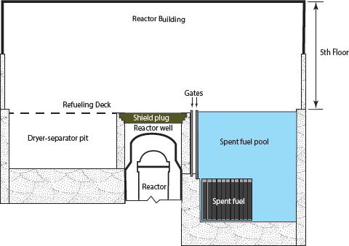
REACTOR AND SPENT FUEL IN POOL REQUIRE
24/7 ELECTRICITY AND WATER FOR COOLING
Notes:
SFP stressed by higher burnup fuel (more heat and radioactivity) and tighter packing , loss of water, coolant, for sfp fire,. Bcause it is not in containment vessel like the reactor, an explosion would release the Cs 137 and other dangerous radionuclides, widely into the environment. The Fukushima Spent fuel pool #4 had more fuel than the reactor and it looked it the water might evaporate enough to expose the fuel rods to air in the pool which would have heated up and ignited the zirconium cladding, resulting in a massive fire and disporsal of Cs 137 and other radionuclides. The PM of Japan was ready to evacuate Tokyo had that happened. Unintentionally, , the Gate was open between the reactor well and the pool, and water was passively flowing into the pool which kept the fuel rods under water and cool enough to avoid meltdown

Slide 14
Cesium-137
40% OF RADIOACTIVITY IN SPENT NUCLEAR FUEL (SNF) is fromCesiums -137
SPENT FUEL POOL LOCATED OUTSIDE THE REACTOR VESSEL
FIRE WOULD RELEASE MUCH MORE CS-137 THAN FROM A REACTOR FIRE (LOADED WITH SEVERAL CORES-WORTH OF SPENT FUEL)
LONG LIVED (T 1/2 =30 YEARS) GAMMA EMITTER, LIKE POTASSIUM IN THE BODY VERY DANGEROUS TO HUMANS FOR >100 YEARS
EXPLOSIVE RELEASE LEADS TO WIDESPREAD LONG LIVED ENVIRONMENTAL CONTAMINATION AS WELL
Notes:
https://sgs.princeton.edu/sites/default/files/2020-12/kang-2017.pdf with zirconium burning, hydrogen is produced in rection between water vapor and hot zirconium more likely the higher the density of storage in the pool. stop
After Fukushima, NRC review concluded that high density packing greatly increased the risk of explosive release into environment, requiring evacuations, etc but said that the likelihood of such an event was too low to change regulations the release of cesium-137 to the atmosphere from a fire in a dense-packed pool would be almost complete and about one hundred times larger than the leakage from a fire in a low-density pool inside an intact reactor building. The release from a high-density pool fire would be so large that, on average, it would require the relocation of the population from an area larger than the State of New Jersey (22,600 km2). https://scienceandglobalsecurity.org/archive/sgs24vonhippel.pdf
In Fukushima, walls and ceilings blew off buildings for reactors 1, 3, and 4. Had the water evaporated in any of those spent fuel pools located above the reactors in these buildings without roofs, they would have exploded, especially in #4 which now contained 2.4 core loads a freshly unloaded amount of spend fuel removed from the reactor awaiting new fuel load.
https://www.sciencedirect.com/science/article/pii/S1470204502007271 Particularly rich sources of ¹³⁷Cs include milk, meat, and potatoes. People living in rural or forested parts of exposed areas received considerable doses of ionising radiation from mushrooms and wild berries, which concentrate radionuclides. The poor condition of the local economy in these areas, and the residents' dependence on these foodstuffs for sustenance are a cause for concer

Slide 15
comparison of cesium-137 inventories
(millions of Curies)
MCi
Sources: NCRP -154, WNA 2016, DOE-GC 859 (2013), DOE EIS-0250, Appendix A, Table A-9.
Notes:
Robert Alvarez
R. Alvarez Johns HopkinsSchool of Advanced International StudiesApril 29, 2017. Song 3 spent fuel
Cesium 137, gamma emitter like xrays, 30 year half life, treated in the body like potassium, associatd with increase in solid tumors, gi tumors,

Slide 16
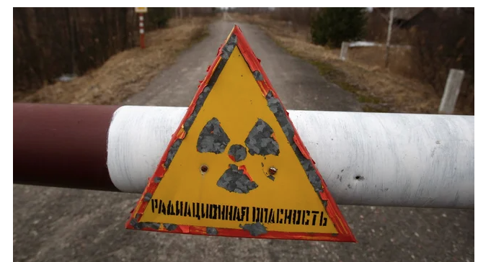
IS NUCLEAR POWER TOO DANGEROUS AS LONG AS THERE IS NO PEACE? LESSONS FROM UKRAINE
Notes:
” cry for Ukrainian independence in the late ’80s and early ’90s, and processing its traumatic effects on the country’s people and environment became an important facet of Ukrainian national identity. By seizing the plant as part of a brutal invasion, Russia is stirring up radioactive particles, and also Chernobyl’s painful legacy: Ukrainians’ memory of the Soviet Union’s disregard for their lives. “ The Atlantic this month

